Slide 1
Query Optimization
Notes:
‹#›

Slide 2
Query Optimization
Introduction
Transformation of Relational Expressions
Notes:
‹#›

Slide 3
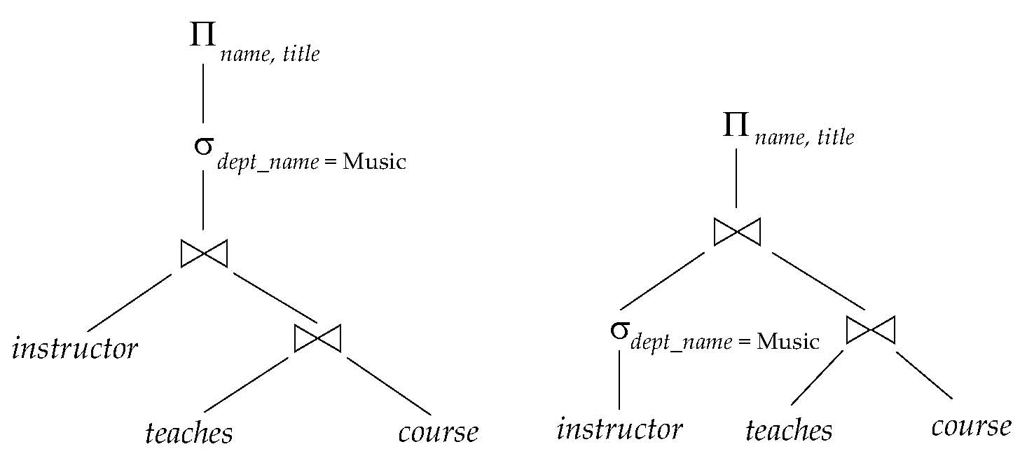
Introduction
Alternative ways of evaluating a given query
Equivalent expressions
Different algorithms for each operation
Notes:
‹#›

Slide 4
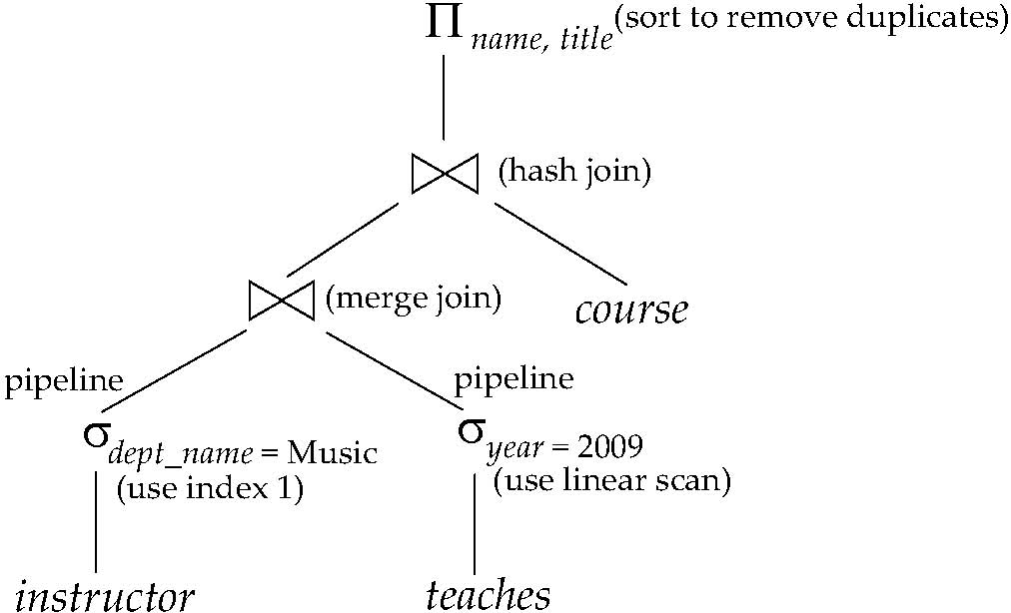
Introduction (Cont.)
An evaluation plan defines exactly what algorithm is used for each operation, and how the execution of the operations is coordinated.
Find out how to view query execution plans on your favorite database
Notes:
‹#›

Slide 5
Introduction (Cont.)
Cost difference between evaluation plans for a query can be enormous
E.g. seconds vs. days in some cases
Steps in cost-based query optimization
Generate logically equivalent expressions using equivalence rules
Annotate resultant expressions to get alternative query plans
Choose the cheapest plan based on estimated cost
Estimation of plan cost based on:
Statistical information about relations. Examples:
number of tuples, number of distinct values for an attribute
Statistics estimation for intermediate results
to compute cost of complex expressions
Cost formulae for algorithms, computed using statistics
Notes:
‹#›

Slide 6
Generating Equivalent Expressions
Notes:
‹#›

Slide 7
Transformation of Relational Expressions
Two relational algebra expressions are said to be equivalent if the two expressions generate the same set of tuples on every legal database instance
Note: order of tuples is irrelevant
we don’t care if they generate different results on databases that violate integrity constraints
In SQL, inputs and outputs are multisets of tuples
Two expressions in the multiset version of the relational algebra are said to be equivalent if the two expressions generate the same multiset of tuples on every legal database instance.
An equivalence rule says that expressions of two forms are equivalent
Can replace expression of first form by second, or vice versa
Notes:
‹#›

Slide 8
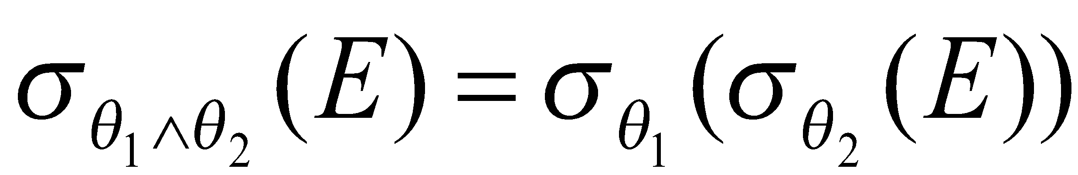
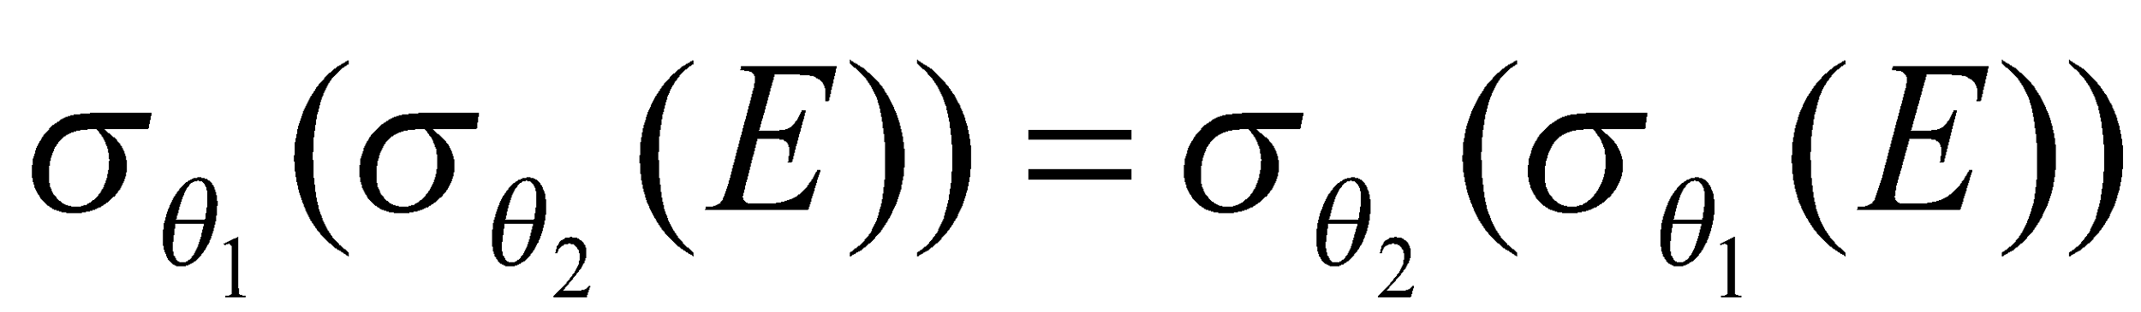
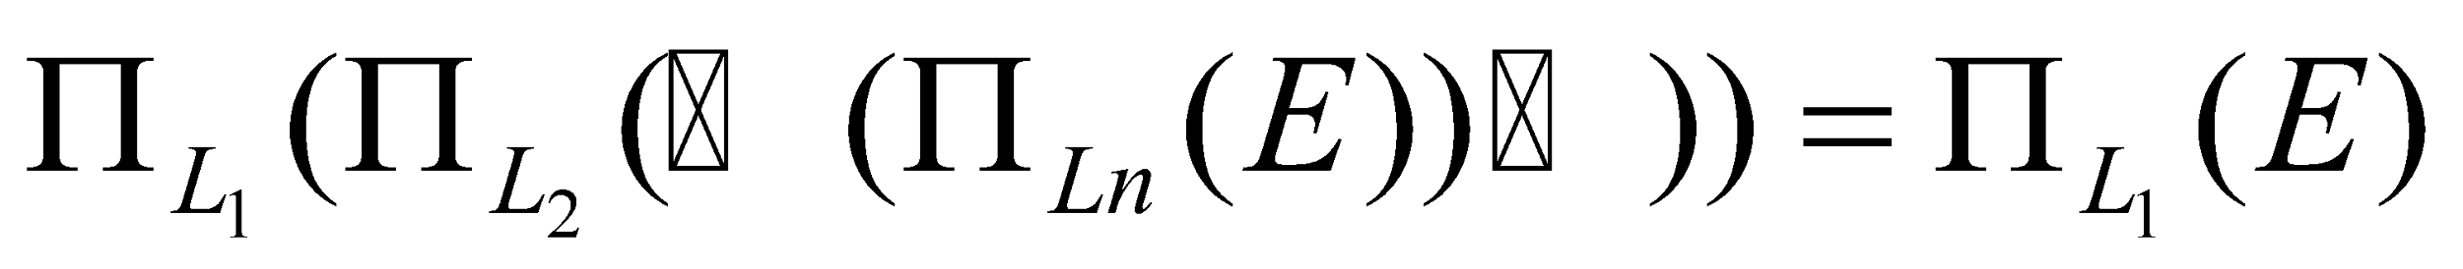
Equivalence Rules
1. Conjunctive selection operations can be deconstructed into a sequence of individual selections.
2. Selection operations are commutative.
3. Only the last in a sequence of projection operations is needed, the others can be omitted.
Selections can be combined with Cartesian products and theta joins.
σ_{θ}(E₁ X E₂) = E₁ _{θ} E₂
σ_{θ1}(E₁ _{θ2} E₂) = E₁ _{θ1∧ θ2} E₂
Notes:
‹#›

Slide 9
Equivalence Rules (Cont.)
5. Theta-join operations (and natural joins) are commutative. E_{1 θ} E₂ = E₂ _{θ} E₁
6. (a) Natural join operations are associative:
(E₁ E₂) E₃ = E₁ (E₂ E₃) (b) Theta joins are associative in the following manner: (E_{1 θ1} E₂) _{θ2∧ θ3} E₃ = E_{1 θ1∧ θ3} (E₂ _{θ2} E₃) where θ₂ involves attributes from only E₂ and E₃.
Notes:
‹#›

Slide 10
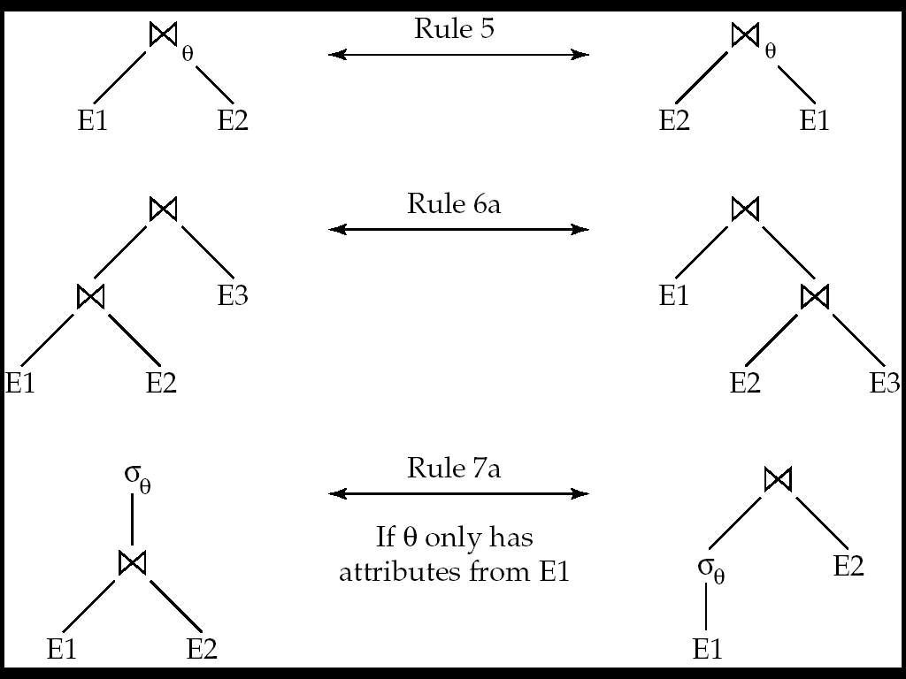
Pictorial Depiction of Equivalence Rules
Notes:
‹#›

Slide 11
Equivalence Rules (Cont.)
7. The selection operation distributes over the theta join operation under the following two conditions: (a) When all the attributes in θ₀ involve only the attributes of one of the expressions (E₁) being joined. σ_{θ0}(E₁ _{θ} E₂) = (σ_{θ0}(E₁)) _{θ} E₂
(b) When θ ₁ involves only the attributes of E₁ and θ₂ involves only the attributes of E₂.
σ_{θ1}∧_{θ2} (E₁ _{θ} E₂) = (σ_{θ1}(E₁)) _{θ} (σ_{θ2} (E₂))
Notes:
‹#›

Slide 12
Equivalence Rules (Cont.)
8. The projection operation distributes over the theta join operation as follows:
(a) if θ involves only attributes from L₁ ∪ L₂:
(b) Consider a join E_{1 θ} E₂.
Let L₁ and L₂ be sets of attributes from E₁ and E₂, respectively.
Let L₃ be attributes of E₁ that are involved in join condition θ, but are not in L₁ ∪ L₂, and
let L₄ be attributes of E₂ that are involved in join condition θ, but are not in L₁ ∪ L₂.
∏
(
E
E
)
=
(
∏
(
E
))
(
∏
(
E
))
L
1
∪
L
2
1
θ
2
L
1
1
θ
L
2
2
∏
(
E
E
)
=
∏
((
∏
(
E
))
(
∏
(
E
)))
L
1
∪
L
2
1
θ
2
L
1
∪
L
2
L
1
∪
L
3
1
θ
L
2
∪
L
4
2
Notes:
‹#›

Slide 13
Equivalence Rules (Cont.)
The set operations union and intersection are commutative E₁ ∪ E₂ = E₂ ∪ E₁ E₁ ∩ E₂ = E₂ ∩ E₁
(set difference is not commutative).
Set union and intersection are associative.
(E₁ ∪ E₂) ∪ E₃ = E₁ ∪ (E₂ ∪ E₃) (E₁ ∩ E₂) ∩ E₃ = E₁ ∩ (E₂ ∩ E₃)
The selection operation distributes over ∪, ∩ and –. σ_{θ} (E₁ – E₂) = σ_{θ} (E₁) – σ_{θ}(E₂) and similarly for ∪ and ∩ in place of – Also: σ_{θ} (E₁ – E₂) = σ_{θ}(E₁) – E₂ and similarly for ∩ in place of –, but not for ∪
12. The projection operation distributes over union
Π_{L}(E₁ ∪ E₂) = (Π_{L}(E₁)) ∪ (Π_{L}(E₂))
Notes:
‹#›

